Slide 1
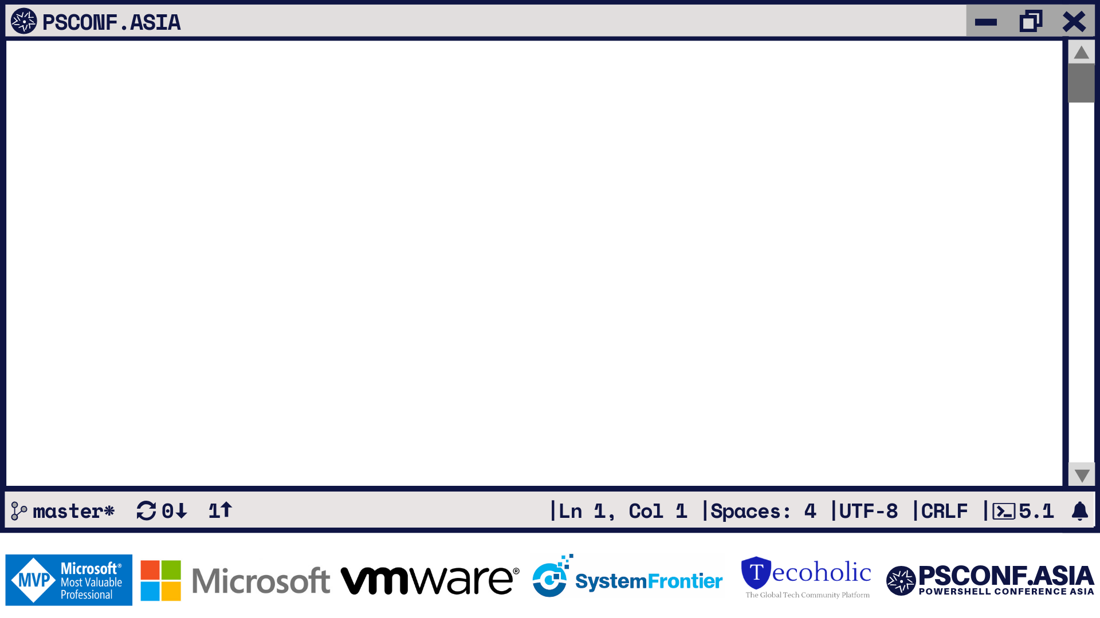
Tools & Cattle
One way of doing this
Luc Dekens
Kyle Ruddy

Slide 2
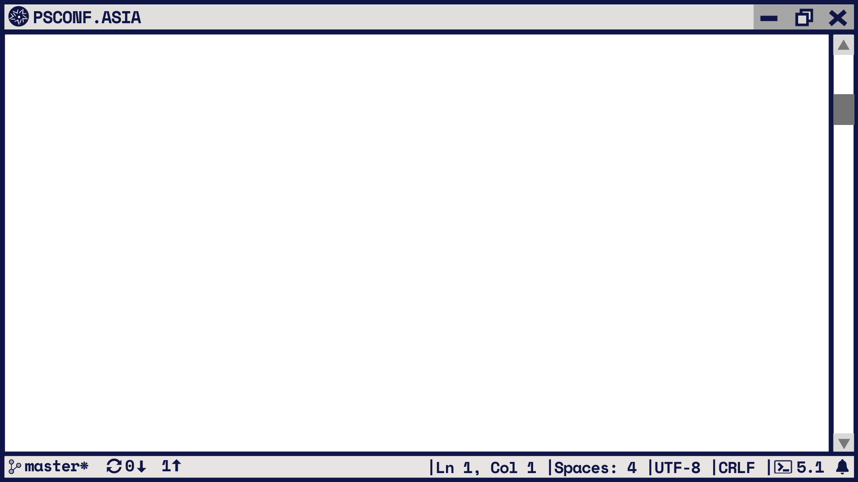
Luc Dekens
PowerCLI Mastermind
Writer
GitHub
Twitter
MS MVP
@ lucd.info
@ github.com/lucdekens
@lucd22
Cloud\Datacenter Management

Slide 3
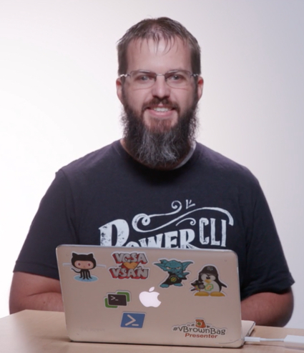
Kyle Ruddy
Senior Architect, Technical Marketing
Writer
GitHub
Podcast
Twitter
MS MVP
@ kmruddy.com
@ github.com/kmruddy
@ vBrownBag.com
@kmruddy
Cloud\Datacenter Management

Slide 4
Intro
Where to develop & run your PS scripts?
PS Core opens new possibilities
Use and dispose (cattle)
Use VMware vSphere platform
On premises
Choice of cloud
PowerShell + VMware PowerCLI
Account of a project
… with all the bumps in the road!

Slide 5
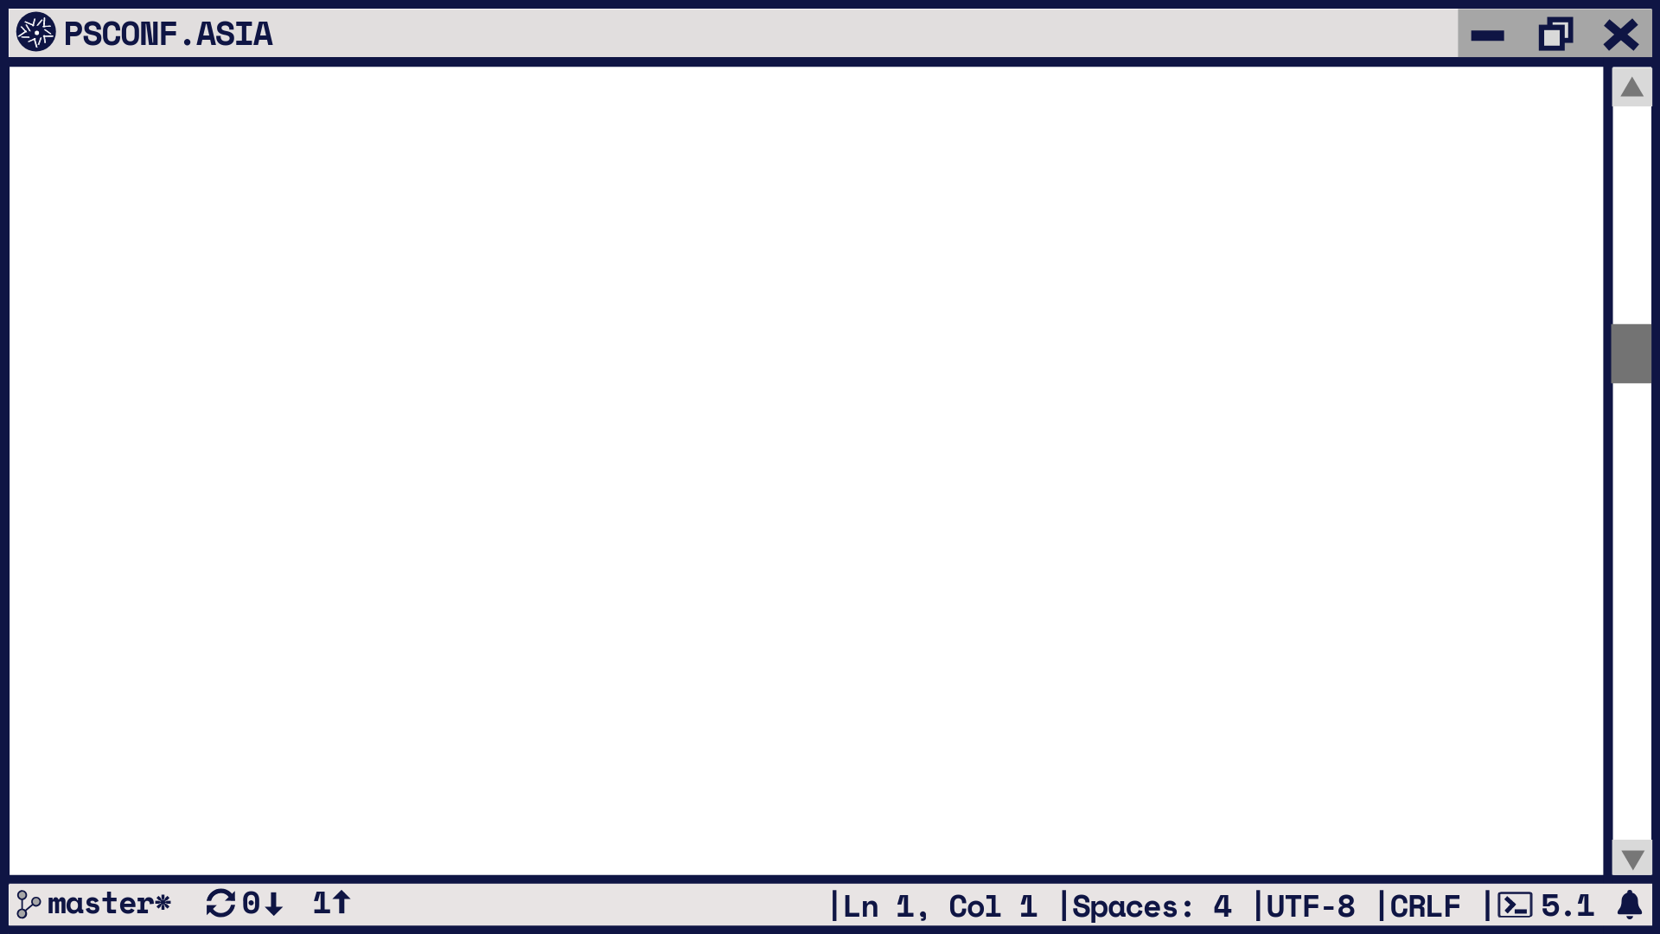
Linux
Practical advantages
Cloud standard
Existing deployment methods
Tested
Documented
Handsfree!

Slide 6
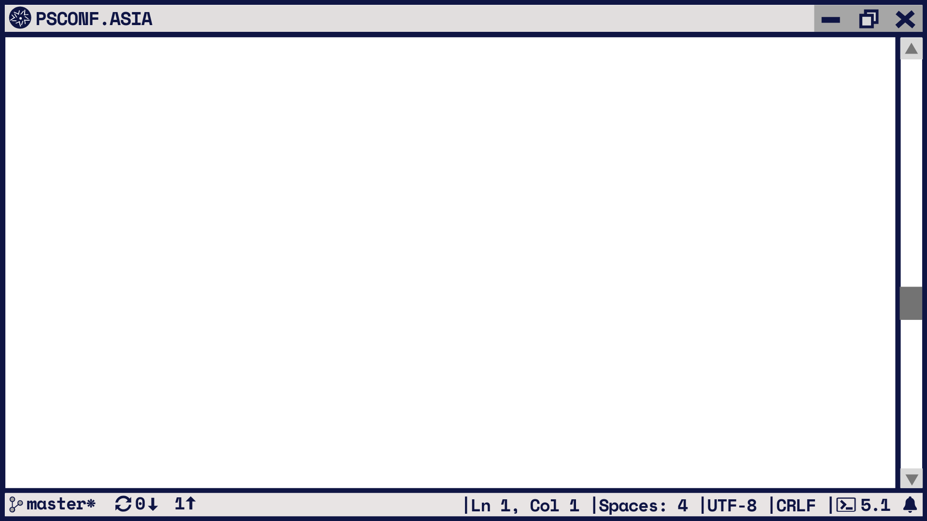
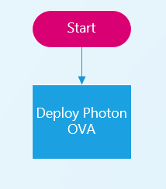
Initial Deployment
Station with PS + VMware PowerCLI
vSphere vCenter
OVA format
Import-VApp

Slide 7
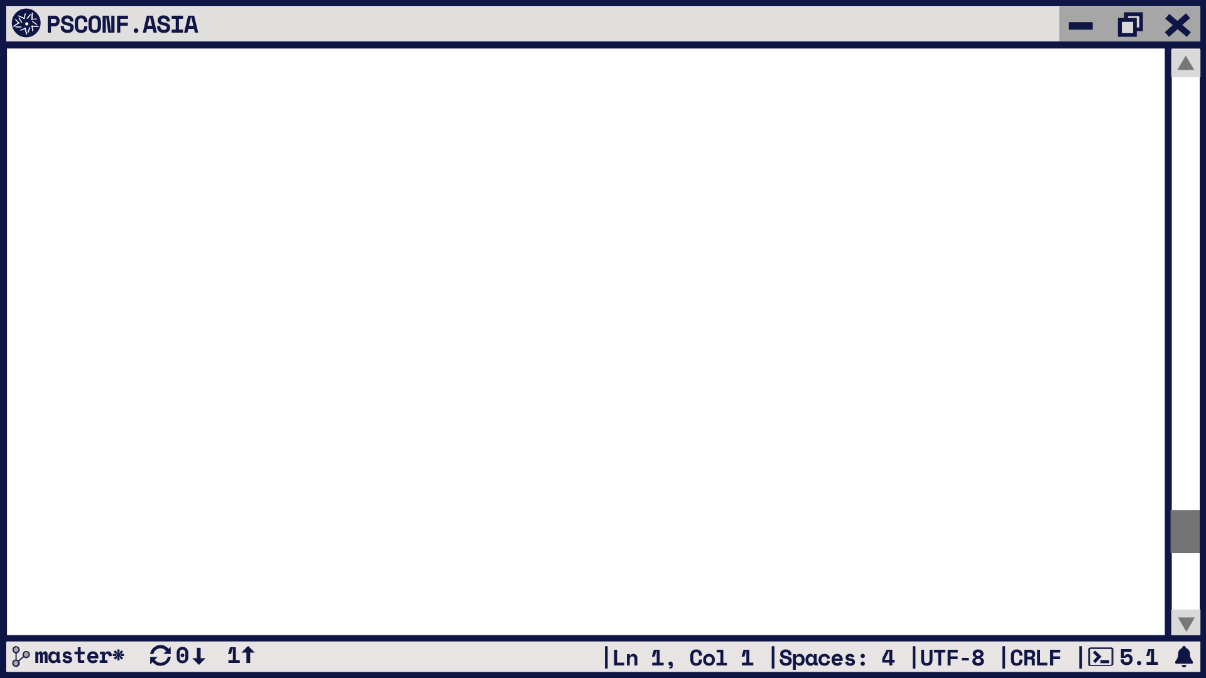
$ovaPath = 'D:\Repo\VMware\Photon\photon-hw13_uefi-3.0-26156e2.ova“’
$ovfParm = Get-OvfConfiguration -Ovf $ovaPath
$ovfParm.NetworkMapping.None.Value = $pg
$sVApp = @{
Name = 'PhotonVM'
Source = $ovaPath
OvfConfiguration = $ovfParm
VMHost = $esx
Datastore = $ds
DiskStorageFormat = 'Thin'
Confirm = $false
}
$vm = Import-VApp @sVApp

Slide 8
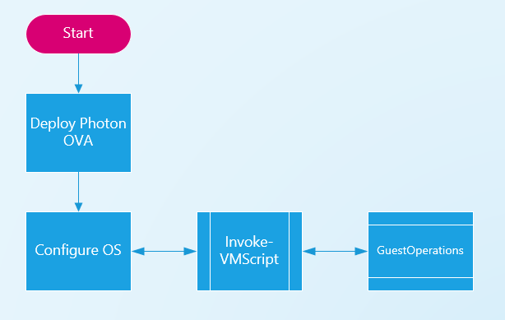
OS Customization
Target not (yet) on network
Invoke-VMScript cmdlet
API: GuestOperations
Requires VMware Tools
Port 902 to ESXi node hosting the VM
Account + privileges in guest OS

Slide 9
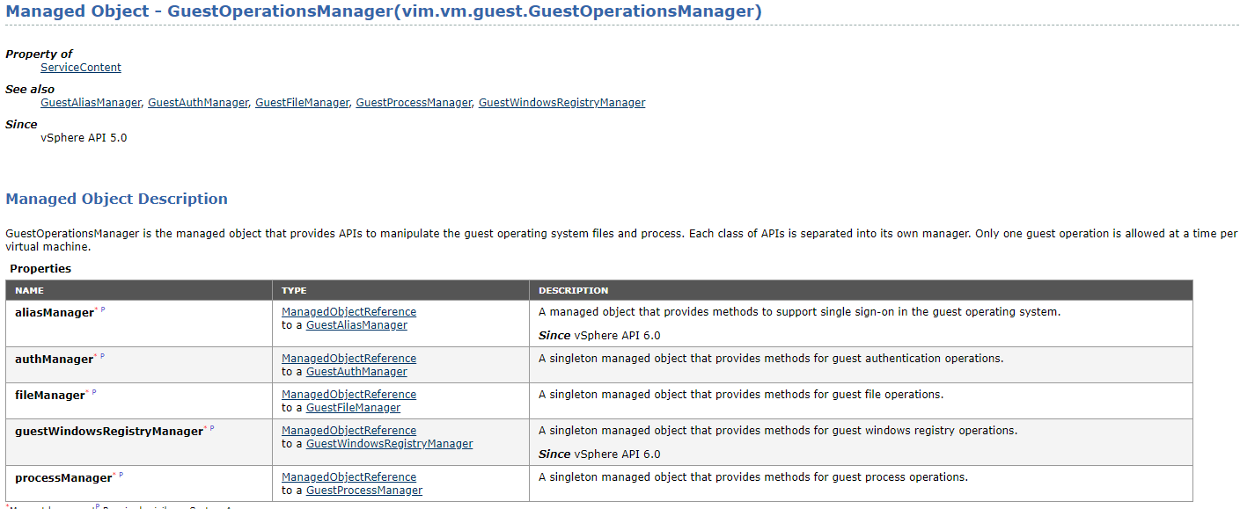
GuestOperations
vSphere Web Services API

Slide 10
$sInvoke = @{
VM = $vm
ScriptType = 'bash'
ScriptText = 'whoami'
GuestCredential = $cred
}
Invoke-VMScript @sInvoke

Slide 11
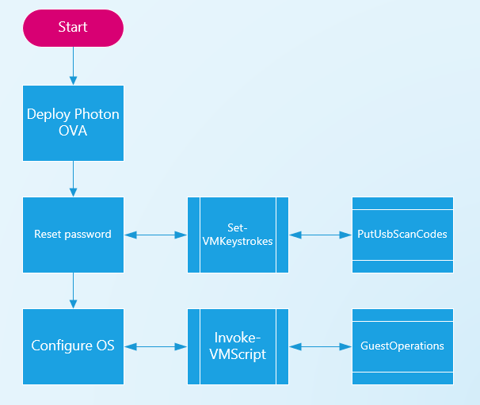
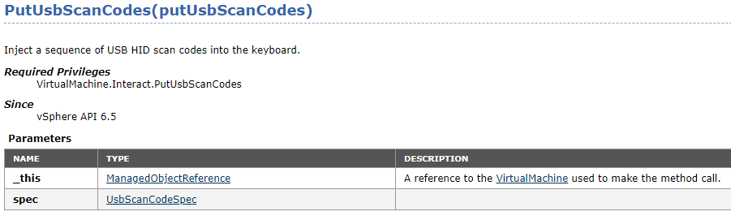
The chicken & the egg
Photon OS requires immediate password change
Blocks use of Invoke-VMScript
Solution:
Emulate keyboard
William Lam’s Set-VMKeystrokes function
API: PutUsbScanCodes

Slide 12
Set-VMKeystrokes -VMName $VM.Name -StringInput 'root' -ReturnCarriage $true | Out-Null
Start-Sleep 1
Set-VMKeystrokes -VMName $VM.Name -StringInput 'changeme' -ReturnCarriage $true | Out-Null
Start-Sleep 1
Set-VMKeystrokes -VMName $VM.Name -StringInput 'changeme' -ReturnCarriage $true | Out-Null
Start-Sleep 1
Set-VMKeystrokes -VMName $VM.Name -StringInput 'VMware1!' -ReturnCarriage $true | Out-Null
Start-Sleep 1
Set-VMKeystrokes -VMName $VM.Name -StringInput 'VMware1!' -ReturnCarriage $true | Out-Null
Start-Sleep 1
Set-VMKeystrokes -VMName $VM.Name -StringInput 'exit' -ReturnCarriage $true | Out-Null

Slide 13
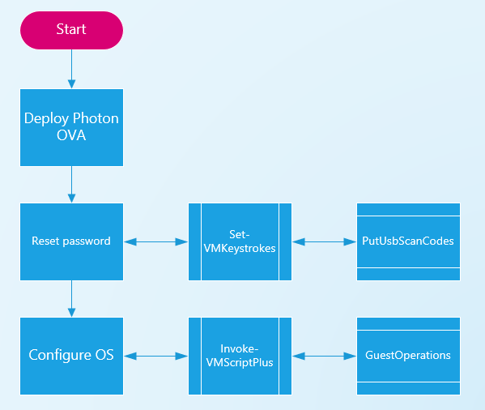
Linux code & Invoke-VMScript
Developed pre-PS Core
Windows!
Limited Linux functionality
No she-bang support (#!/usr/bin/env bash)
No here document support
Limited size for bash (+/- 2600 chars)
Invoke-VMScriptPlus function
lucd.info
PS Core support
Side-by-side support
…

Slide 14
$code = @'
tdnf update open-vm-tools -y
/bin/vmware-toolbox-cmd -v
'@
$sInvoke = @{
VM = $vm
GuestCredential = $cred
ScriptType = 'bash'
ScriptText = $code
GuestOSType = 'Linux'
}
Invoke-VMScriptPlus @sInvoke

Slide 15
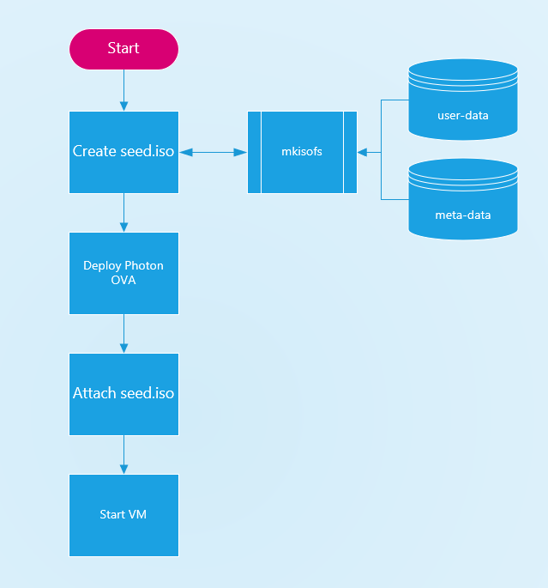
Cloud friendly?
Customisation scripts ⬅ Not standardized
Alternative: cloud-init
Test with stand-alone datasource
OVA + seed.iso
Seed.iso requires mkisofs
Work Photon station

Slide 16
Root password (again)
#cloud-config
chpasswd:
list: |
root:password
expire: False
The ‘normal’ way in cloud-init
Known issue:
2019-09-14 13:46:56,169 - helpers.py[DEBUG]: Running config-users-groups using lock (<FileLock using file '/var/lib/cloud/instances/iid-datasource-none/sem/config_users_groups'>)
2019-09-14 13:46:56,169 - __init__.py[INFO]: User root already exists, skipping.
2019-09-14 13:46:56,169 - handlers.py[DEBUG]: finish: init-network/config-users-groups: SUCCESS: config-users-groups ran successfully
User root already exists, skipping.

Slide 17
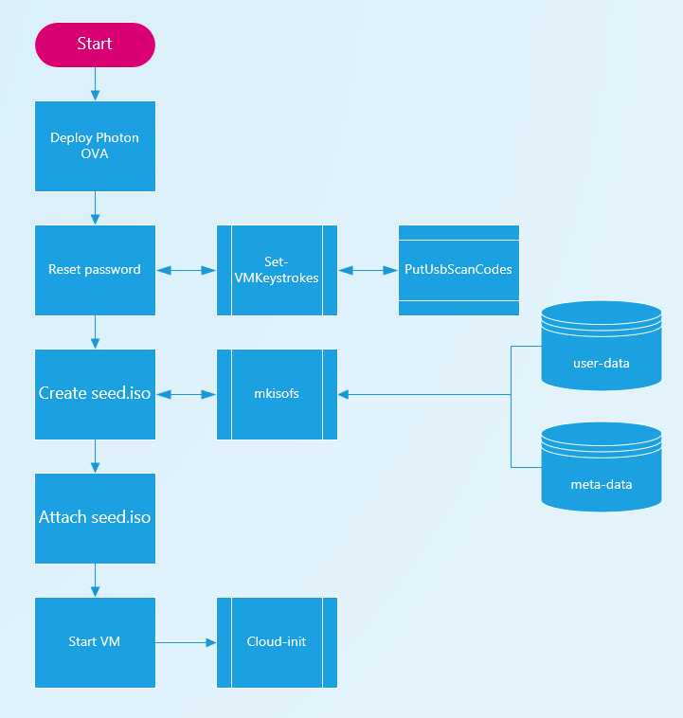
Keystrokes (again)
Deploy OVA
Use William’s Set-VMKeyStrokes
Attach seed.iso
Reboot (triggers cloud-init)

Slide 18
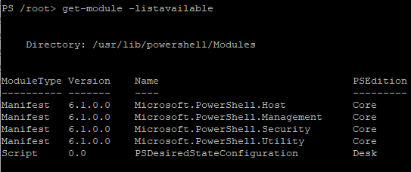
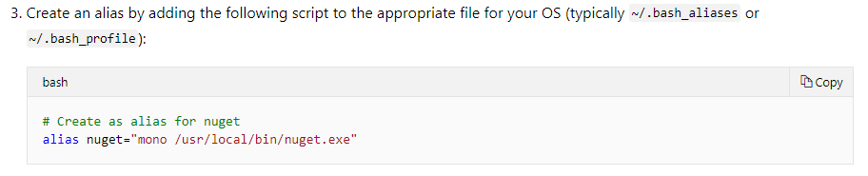
The PS Core part 1
Package in tdnf for ‘powershell’
Version 6.1.0
Limited set of modules
No way to install modules
Alternative: install tar from MSFT repo
Not compiled with Photon libraries
No PSRespository ⬅ No VMware.PowerCLI
Caused by nuget.exe (32 bit)
MSFT proposes mono as solution
Alias for nuget.exe

Slide 19
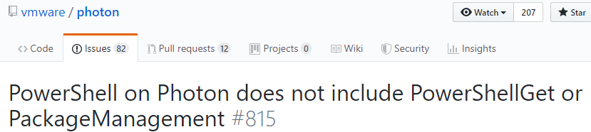
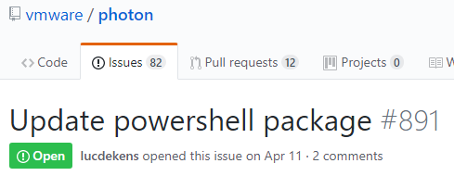
The PS Core part 2
Issues raised in Photon
Express your support

Slide 20
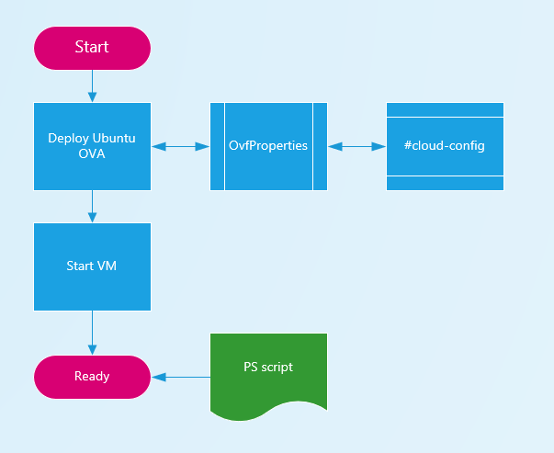
Working alternative
Docker
MSFT provides PS Core (on Ubuntu)
But then why Photon?
Throw away all our experience?
Not really
Gained cloud-init experience
Ubuntu OVA
OVF property (Common.user_data.Value)
No need for seed.iso

Slide 21
Deploy VM when needed
Scheduled scripts
Development platform
Add components: VSC, git, …
Advantages
Resources only used when needed (not another 5% VM)
No maintenance/patching
Scale (1.. ∞) ⬅ same script/same platform
SDDC
No manual intervention
Version control

Slide 22
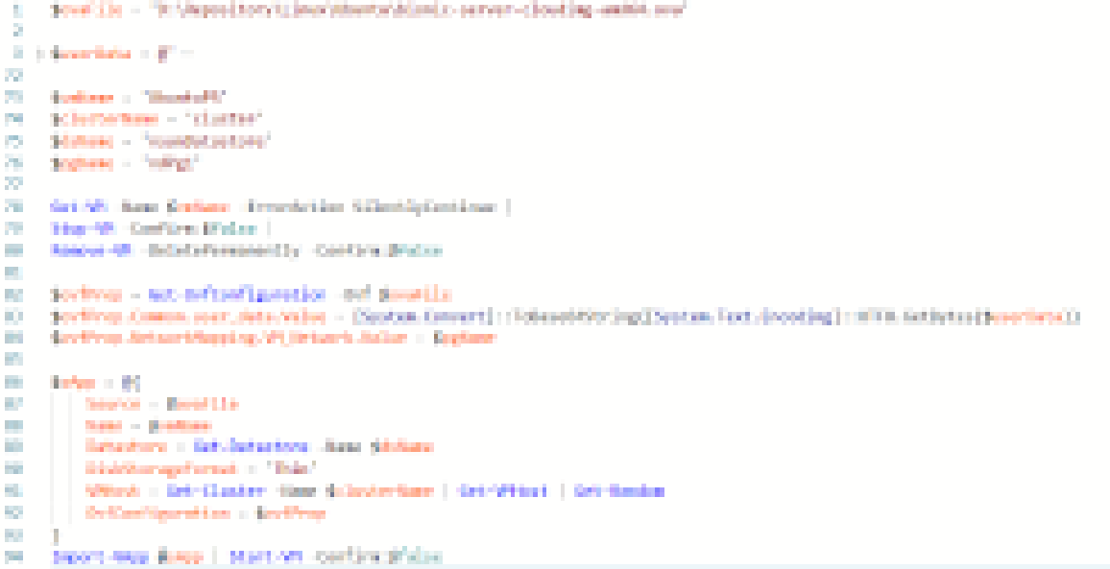


Slide 23
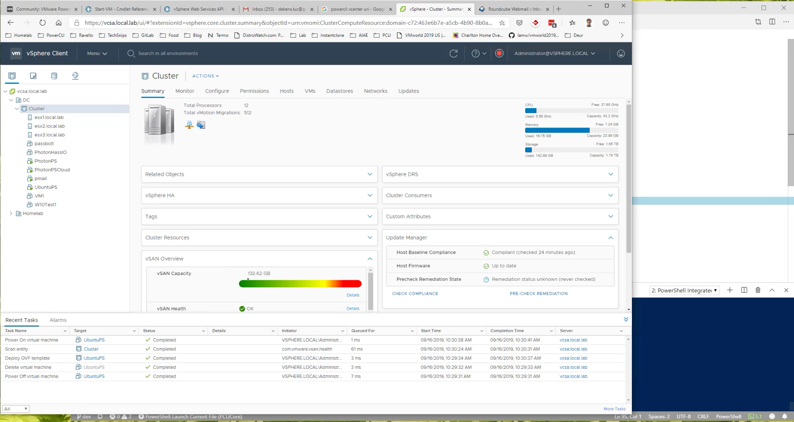

Slide 24
Sample Code
$code = @'
if (-not (Get-Module -Name VMware.PowerCLI -ListAvailable))
{
Install-Module -Name VMware.PowerCLI -Scope CurrentUser -Force -Confirm:`$false
}
Set-PowerCLIConfiguration -InvalidCertificateAction Ignore -Confirm:`$false | Out-Null
Connect-VIServer -Server vcsa.local.lab -Session $($global:DefaultVIServer.SessionSecret) | Out-Null
Get-VMHost |
Select-Object Name, ConnectionState, PowerState, NumCpu, MemoryTotalGB, Model, Version
'@
$sInvoke = @{
VM = 'UbuntuPS'
ScriptType = 'powershellv6'
ScriptText = $ExecutionContext.InvokeCommand.ExpandString($code)
GuestUser = 'luc'
GuestPassword = ConvertTo-SecureString -String ’VMware1!' -AsPlainText -Force
GuestOSType = 'Linux'
}
Invoke-VMScriptPlus @sInvoke

Slide 25
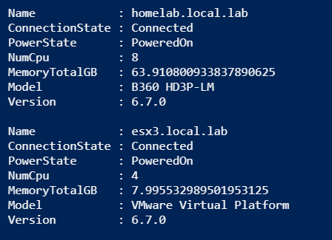
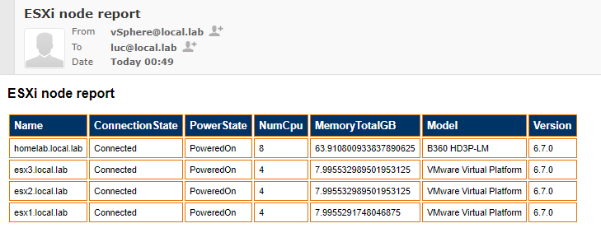
Sample Output

Slide 26
Key takeaways
Everything is “posh”able!
Failure is not failure!
Adopt PS Core
Linux flavours
Broaden your horizon
Have fun!!!

Slide 27
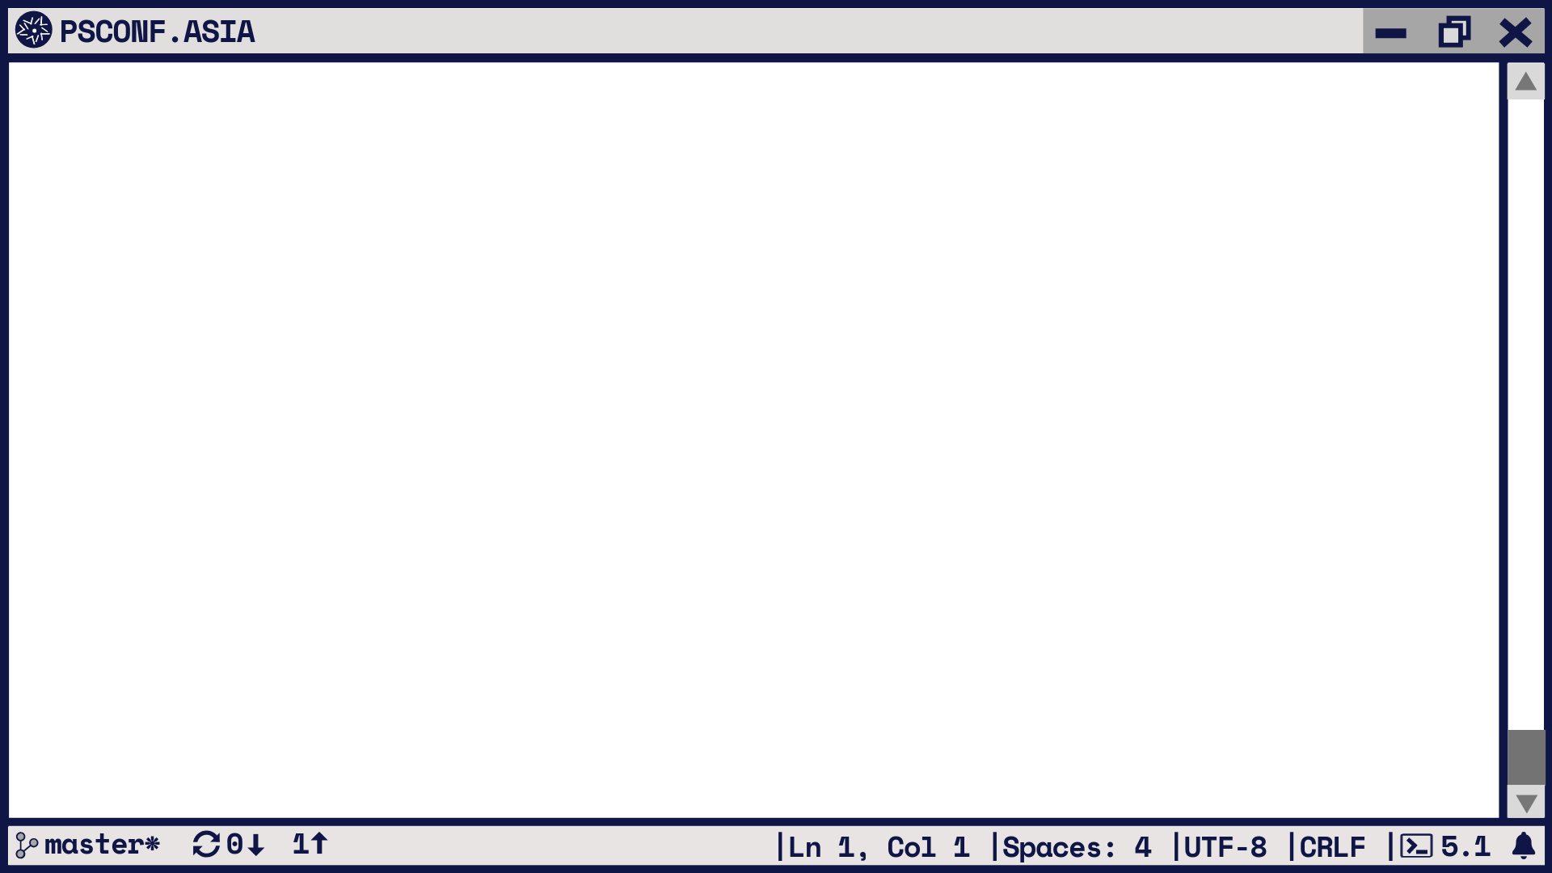
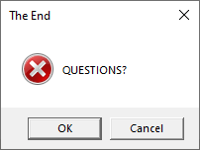

Slide 28
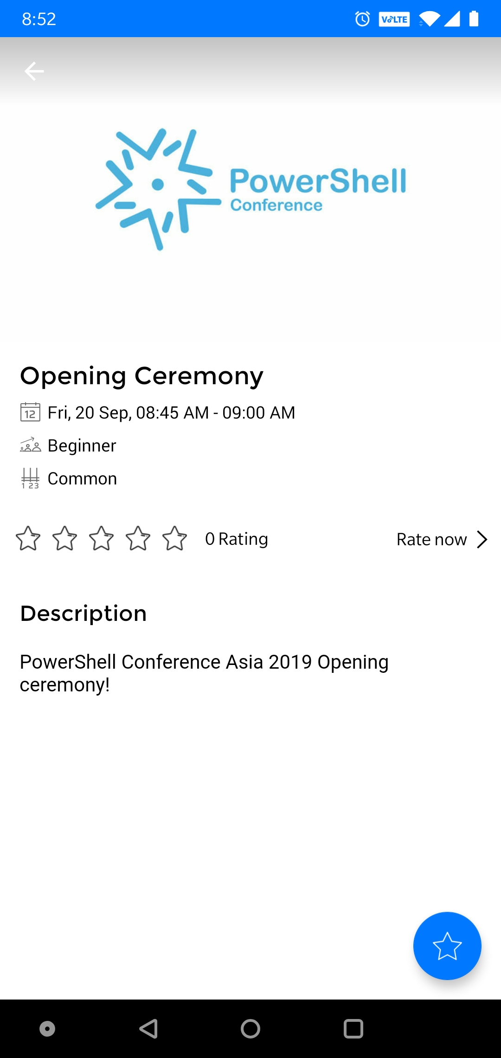
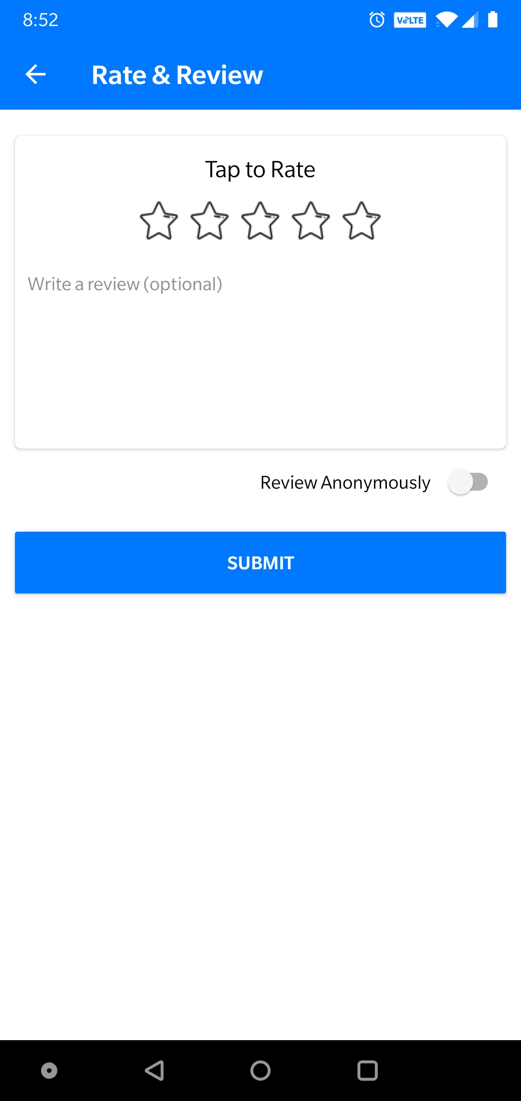

DO NOT Forget to rate the sessions!
https://my.eventraft.com/psconfasia19

